Slide 1
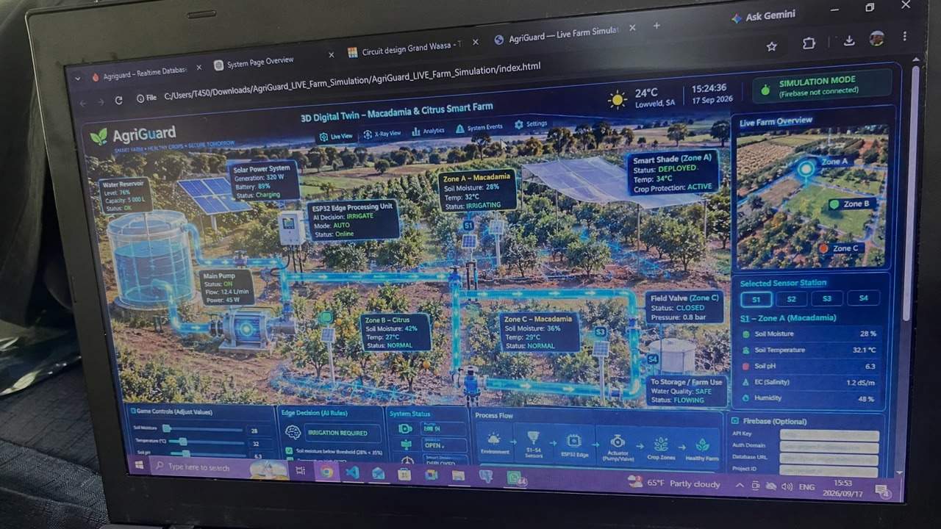
HERCode PRESENTS
AgriGuard
SMART FARMING THAT RESPONDS
TO EACH ZONE IN REAL TIME
Macadamia • Citrus • Zone-specific sensing • Automated protection
ZONE A
ZONE B
ZONE C
HerCode

Slide 2
01 • PROBLEM
02
Problem Statement
In the Lowveld of Mpumalanga, particularly around the Mbombela, White River agricultural region, citrus & macadamia farmers operate in a subtropical environment where crop production is increasingly exposed to fluctuating temperatures, uneven rainfall, periods of low soil moisture and extreme heat. These conditions can vary significantly across different sections of the same orchard, meaning that one area may have adequate soil moisture while another is already experiencing water or heat distress.
This is particularly important during periods of high crop water demand such as August and September, when low rainfall, high temperatures and low relative humidity can increase irrigation requirements.
Without continuous, zone-specific monitoring of soil moisture and temperature, farmers may not detect localised crop stress early enough or know exactly where intervention is required. This can result in inefficient irrigation, unnecessary water use and increased risk of crop stress and reduced crop productivity.
THE FARMING REALITY
Fluctuating
temperatures
Uneven
rainfall
Low soil
moisture
Extreme
heat
Different sections of one orchard can need different responses.
HerCode • AgriGuard
SMART FARM • HEALTHY CROPS • SECURE TOMORROW

Slide 3
02 • SOLUTION
03
Solution Statement
Our solution is AgriGuard, a smart farming system that monitors the farm and automatically responds when plants are under stress. Instead of the farmer having to constantly check every part of the farm, AgriGuard monitors temperature, soil moisture, rainfall and water levels and takes actions when needed.
When temperature becomes too high, the system detects the heat and automatically uses a motor to pull a shade cloth over the plants to protect them from excessive heat and direct sunlight. When the soil becomes too dry the system identifies the affected zones, checks the water tank and automatically turns on the pump to water only the area.
When the water tank becomes too low, the system stops irrigation and alerts the farmer to refill it. When rain is detected irrigation automatically stops to prevent water wastage. The system also provides weather updates through a voice feature telling the farmer the outside temperature and weather conditions.
It uses this information together with the farm sensors to update the farm status and tell the farmer whether the farm needs to be checked or not; everything is under control. All the information is displayed on the farmer's dashboard, allowing the farmer to see the condition of each zone, the water level and what the system is doing in real time. The system is also solar powered using solar energy and a battery to keep it running.
SENSE
DECIDE
ACT
ALERT
DASHBOARD
SOLAR
HerCode • AgriGuard
SMART FARM • HEALTHY CROPS • SECURE TOMORROW

Slide 4
04 • DEMONSTRATION
05
Zone A — Macadamia: Heat Distress
RESEARCH STATEMENT
DEMONSTRATION
Our research on macadamia showed that the ideal temperature is about 16–25°C. At temperatures above 35°C, heat stress can reduce photosynthesis, damage flowers and reduce nut set. Macadamia trees require approximately 500–600 mm of water per year for sustained yield. High water demand is especially important during periods such as August and September.
Zone A is macadamia. We deliberately demonstrate a temperature above 35°C so the system recognises heat distress.
1
2
3
4
Temperature
>35°C
→
ESP32 detects
heat stress
→
Servo / motor
activates
→
Shade cloth
covers Zone A
IDEAL 16–25°C
HEAT STRESS >35°C
Result: the shade cloth protects the macadamia trees from excessive heat and direct sunlight.
HerCode • AgriGuard
SMART FARM • HEALTHY CROPS • SECURE TOMORROW

Slide 5
05 • DEMONSTRATION
06
Zone B — Citrus: Dry Soil
RESEARCH STATEMENT
DEMONSTRATION
Our research on citrus showed that citrus requires frost-free conditions, with an approximate temperature range of 15–30°C, and requires approximately 700–1200 mm of total crop water per year as a planning range.
Zone B is citrus. We demonstrate low soil moisture. When the moisture reading falls below the set threshold, AgriGuard irrigates Zone B only.
1
2
3
4
Dry soil
sensed
→
Zone B
identified
→
Pump turns
ON
→
Irrigation
Zone B only
15–30°C
≈700–1200 mm/year
For the demonstration, the key trigger is dry soil.
Result: water is applied only where the soil is dry.
HerCode • AgriGuard
SMART FARM • HEALTHY CROPS • SECURE TOMORROW

Slide 6
06 • DEMONSTRATION
07
Zone C — Macadamia: Normal Conditions
RESEARCH STATEMENT
DEMONSTRATION
For macadamia, our researched ideal temperature is about 16–25°C. Zone C will demonstrate a healthy macadamia zone within this temperature range and with adequate soil moisture.
Zone C is macadamia and everything is normal. AgriGuard continues sensing, but it does not turn on irrigation and it does not deploy the shade cloth.
✓
SYSTEM STATUS: NORMAL
16–25°C
ADEQUATE MOISTURE
Monitor only • No actuator required • No unnecessary water use
No stress condition is triggered.
HerCode • AgriGuard
SMART FARM • HEALTHY CROPS • SECURE TOMORROW

Slide 7
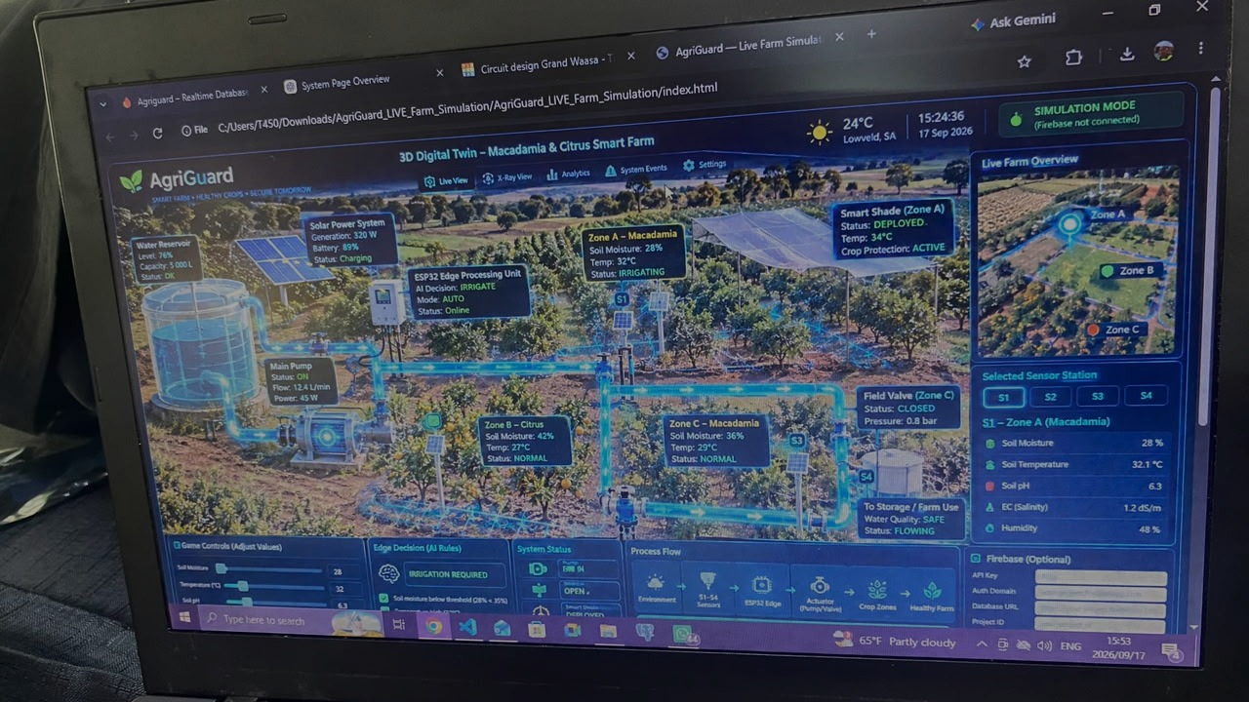
AgriGuard
ONE FARM • THREE ZONES • THE RIGHT RESPONSE
Sense locally.
Respond intelligently.
HerCode
THANK YOU

